Slide 1
Predicting laptop Prices “What Really Drives the Market?”
Abdullah Ihsan Taslim

Slide 2


AGENDA
INTRODUCTION
The Market Landscape
Dominant features
Model Specification
Business Value

Slide 3

INTRO
The aim of this study is to analyze dataset that contains detailed information about 1,302 laptops from various manufacturers. And Implementing ETL, EDA and Modelling in order to answer these question: “What features contributes to price increase?” “Can a model be made to predict laptop price accurately?”

Slide 4
Intro
Feature | Description
Unnamed: 0 | Unique identifier/index
Company | Laptop manufacturer (Apple, HP, Dell, Lenovo, etc.)
TypeName | Laptop category (Notebook, Ultrabook, Gaming, Workstation, etc.)
Ram | Installed RAM size (GB)
Weight | Laptop weight
Price | Laptop price (Target Variable)
TouchScreen | Indicates whether the laptop has a touchscreen (0/1)
Ips | Indicates IPS display technology (0/1)
ppi | Pixels per inch (screen pixel density)
Cpu Brand | Processor manufacturer/brand
HDD | Hard Disk Drive storage capacity (GB)
SSD | Solid State Drive storage capacity (GB)
Gpu Brand | Graphics card manufacturer
os | Operating System category
Data description

Slide 5
The Market Landscape
Data Findings Based on the dataset

Slide 6
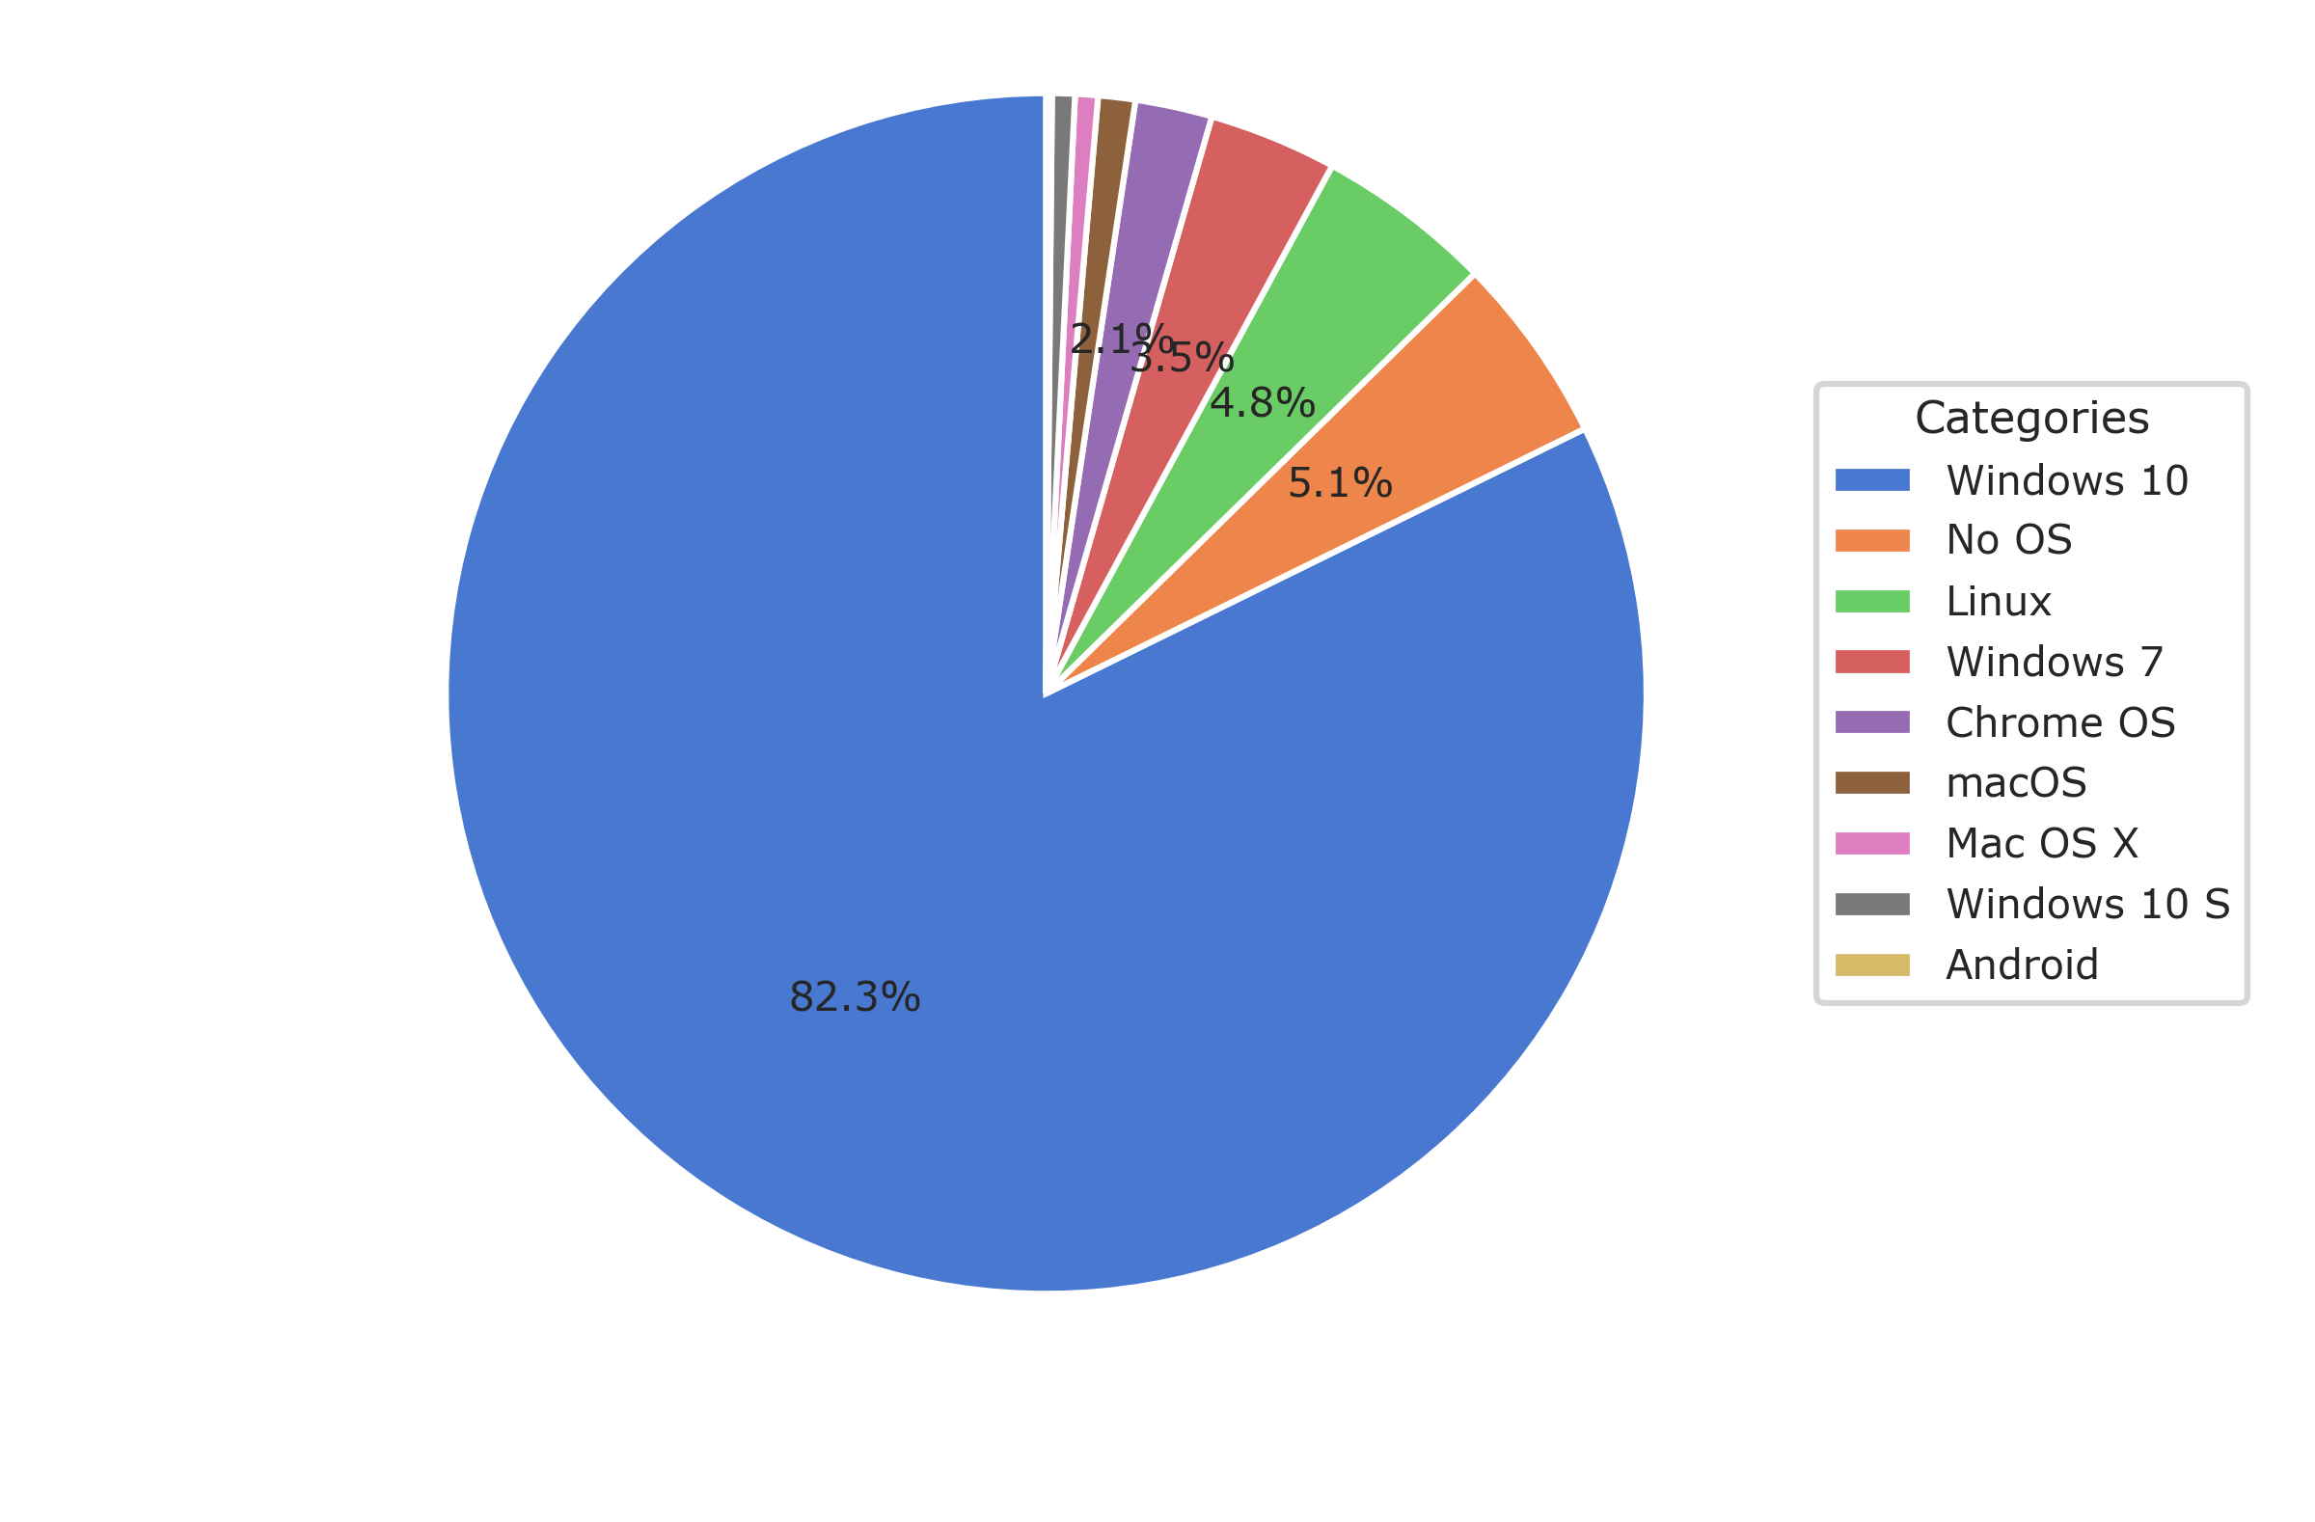

Microsoft Dominates the ecosystem with windows 10

Slide 7
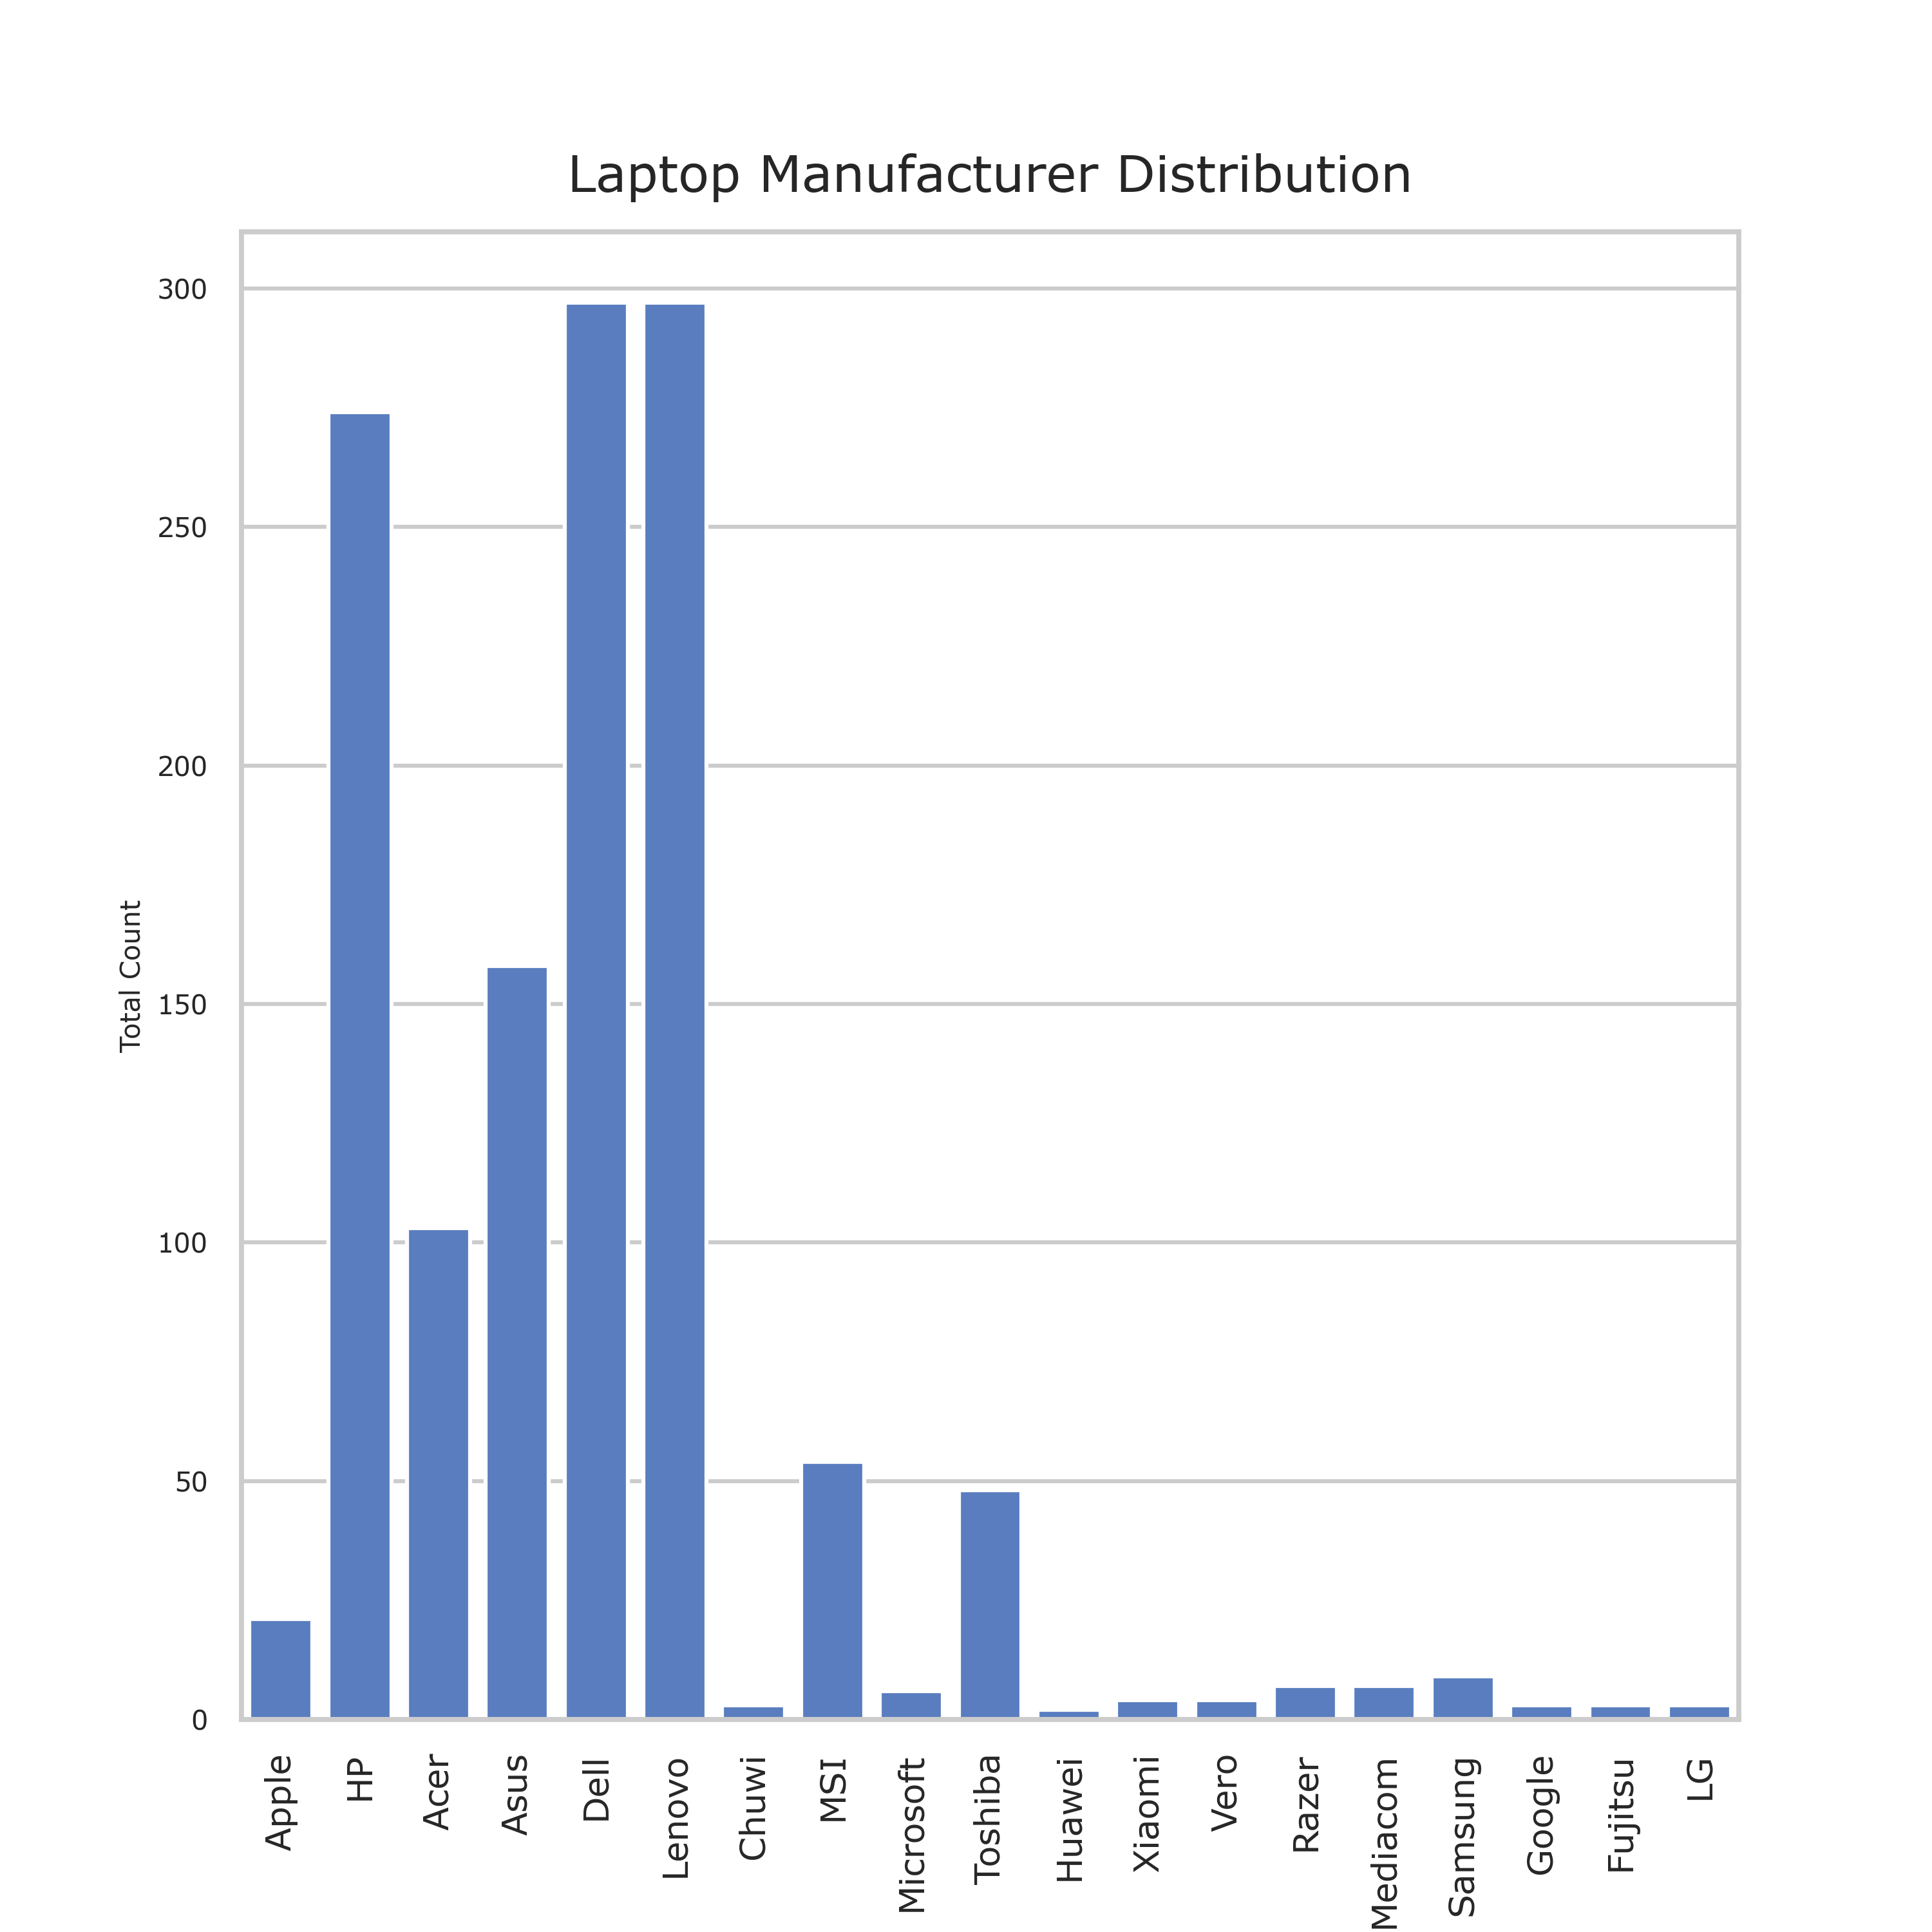
Meawhile Lenovo, Dell & HP dominate the hardware

Slide 8
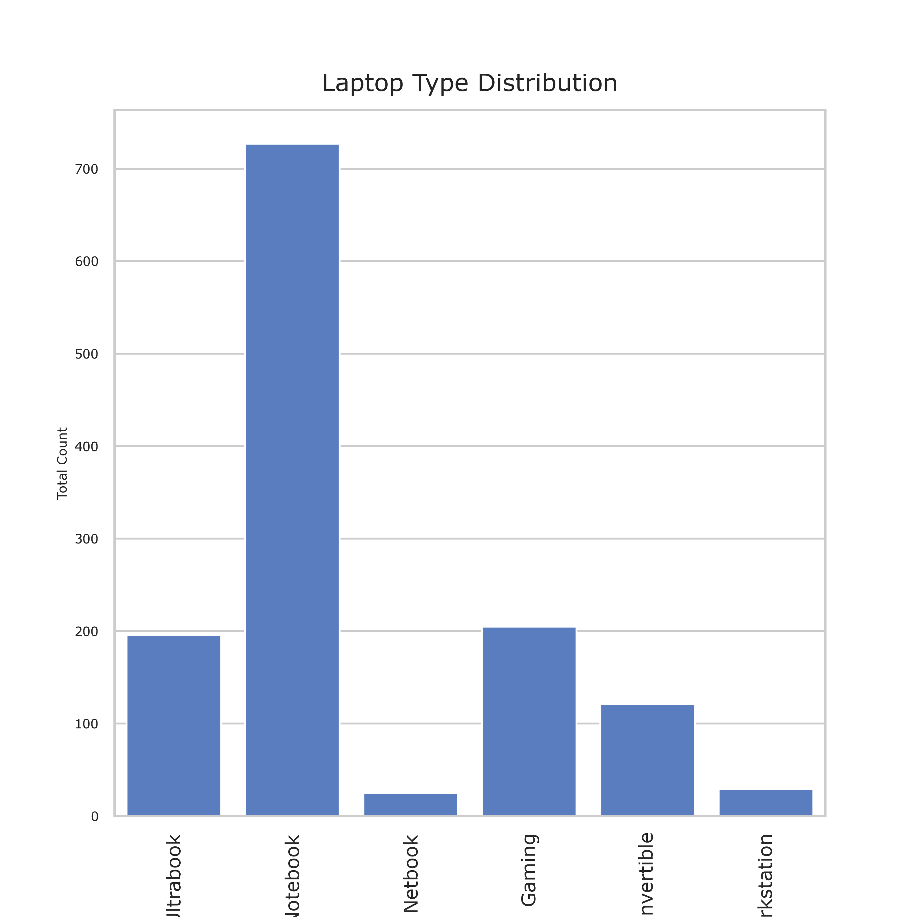
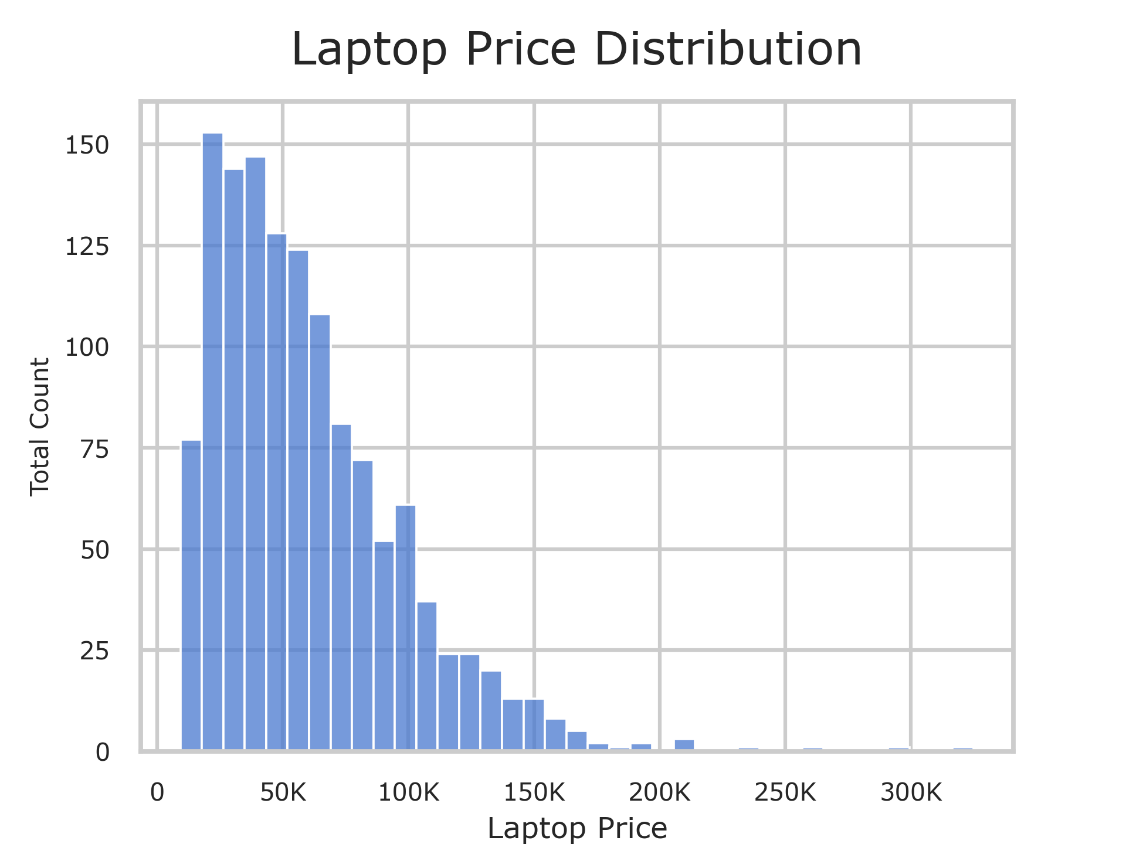
Lower end device, notebook Prices around 50K saturating the market

Slide 9
Thus, What is the features that dictate the prices?
“
”

Slide 10
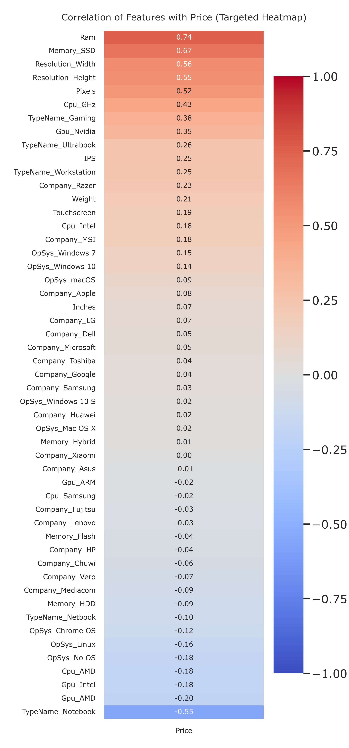
RAM & SSD Are the dictators of the price
Feature | Correlation with Price
RAM | 0.74
SSD | 0.67
Screen size (Pixels) | 0.52
CPU GHz | 0.43
Nvidia GPU | 0.35
Laptop Type (Gaming & Notebook) | (Gaming=0.38 & Notebook=-0.55)
* The closer it gets to 1 & -1 the stronger it is at affecting price
* There is also “gaming premium” that indicate specialized, pricier hardware (as noted by Nvidia GPU & Gaming Laptop Type)

Slide 11
These features are What’s going to shape the model
Feature | Correlation with Price
RAM | 0.74
SSD | 0.67
Screen size (Pixels) | 0.52
CPU GHz | 0.43
Nvidia GPU | 0.35
Laptop Type (Gaming & Notebook) | (Gaming=0.38 & Notebook=-0.55)
* Using a threshold of correlation point > 0.3 & < -0.3 to get moderate to strong correlation with price

Slide 12
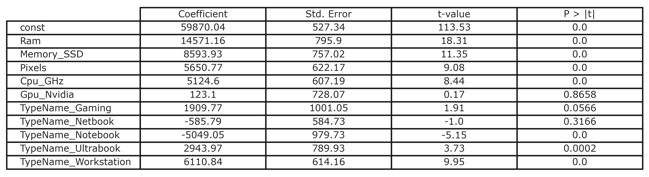
the prediction model using Multiple linear regression (Scaled)
Price = (59870.0429) + (14571.1575 * Ram) + (8593.9328 * Memory_SSD) + (5650.7677 * Pixels) + (5124.6021 * Cpu_GHz) + (123.1021 * Gpu_Nvidia) + (1909.7656 * TypeName_Gaming) + (-585.7866 * TypeName_Netbook) + (-5049.0506 * TypeName_Notebook) + (2943.9682 * TypeName_Ultrabook) + (6110.8416 * TypeName_Workstation)

Slide 13
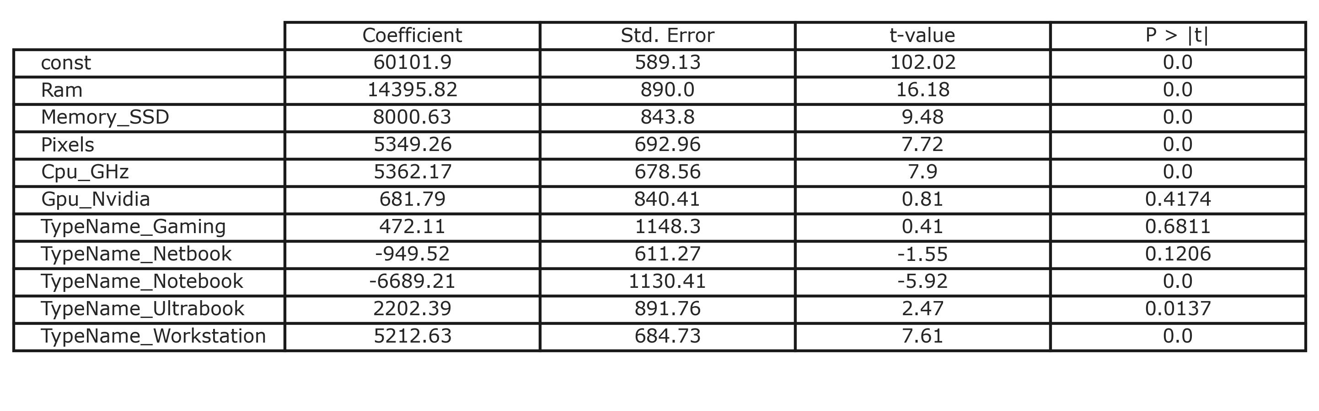
Upgrading Ram almost cost double than better screen or CPU
Variable summary of the Prediction Model
* Looking at Coefficient of the model Ram affecting price by 14.395,82 point almost double SSD at 8.000,63 point & triple Pixels at 5.349,26 point

Slide 14
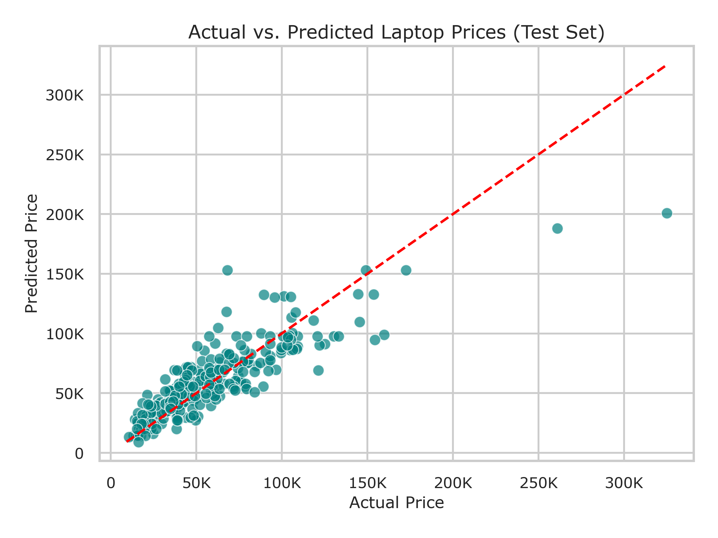
The models Performance
The tight cluster of green dot following the red line, depict the model could works beautifully on predicting cheaper laptop.
On average the model is off by about 13,638.00

Slide 15
The models Performance
Although, Looking at outlier on the right-side pricier laptop are harder to predict. This is due to the lack of luxurious laptop data on the dataset.

Slide 16

Business Value
How can this model be used?
Automatically spotting underpriced laptops for resale.
helping manufacturers price new models competitively.

Slide 17
THANK YOU
Abdullah Ihsan Taslim
ihsantaslim@gmail.com
https://github.com/IhsanTaslim

